Slide 1
Educational Organization Using ServiceNow

Slide 2
Abstract:
Educational organizations are essential societal structures that go beyond simply teaching. They are dynamic systems – from schools to universities – that shape intellectual and personal growth. These organizations are goal-oriented, have defined structures, and demand specialized skills. They continually adapt to change, with strong leadership being crucial for success. Challenges include managing resources and ensuring equitable access to quality education. Ultimately, their effectiveness is measured by their ability to empower individuals, foster social mobility, and contribute to a just society.

Slide 3
Key Features of ServiceNow for Education
ServiceNow offers customizable modules tailored to educational needs, such as student services, HR, and IT management.
It provides a centralized platform for tracking requests, incidents, and asset management within the institution.
Automation capabilities help reduce manual tasks, freeing staff to focus on strategic initiatives

Slide 4
Student Services Management
ServiceNow enables seamless management of student inquiries, admissions, and academic records.
Automated workflows facilitate timely responses and reduce processing times for student requests.
Self-service portals empower students to access information and submit requests independently

Slide 5
IT Service Management in Education
Educational institutions use ServiceNow to manage IT assets, support tickets, and infrastructure requests efficiently.
It helps in maintaining high levels of IT service availability and quick resolution of technical issues.
Integration with other campus systems ensures a unified approach to campus-wide technology management

Slide 6
Asset and Facility Management
Educational organizations utilize ServiceNow to track and maintain campus assets and facilities.
Preventive maintenance schedules are automated, reducing downtime and operational costs.
Real-time reporting provides insights for better resource allocation and planning

Slide 7
Enhancing Communication and Collaboration
ServiceNow fosters collaboration through integrated communication tools and shared workspaces.
It enables timely updates and notifications for students, staff, and stakeholders about relevant services.
The platform supports a unified communication approach, improving overall engagement

Slide 8
Purpose
Educational organizations utilize ServiceNow for a wide range of purposes, primarily focused on streamlining operations, enhancing the student and faculty experience, and improving overall efficiency and security across campus. Here's a breakdown of the key purposes:
Streamlined Administration and Operations: * Efficient resource management: Optimizing the use of classrooms, labs, equipment, and other campus resources, reducing waste and ensuring proper allocation. * Centralizing systems and data: ServiceNow acts as a unified platform, replacing fragmented legacy systems and spreadsheets, providing a single source of truth for various operations. This leads to better data insights and informed decision-making. * HR Service Delivery: Streamlining HR processes for faculty and staff, from onboarding to managing employee requests and information. * Finance and Supply Chain Operations: Managing accounts payable, sourcing, procurement, and supplier lifecycles.
Enhanced Student Experience: * Improved communication and collaboration: Fostering seamless interaction between students, faculty, and administrators through a centralized communication hub, including announcements and alerts. * Housing management: Efficiently managing student housing, including room allocation, change requests, and billing.
Empowering Faculty and Staff: * Reduced administrative tasks: Automating routine tasks for faculty and staff so they can dedicate more time to teaching, research, and student interaction.
Enhanced Campus Safety and Security: * Rapid incident reporting and response: Enabling swift reporting of issues and emergencies, leading to quicker resolution and a safer campus environment. * Integration with security systems: Connecting with surveillance cameras, access control, and other security systems to create a unified security network and proactively address vulnerabilities.
Driving Digital Transformation: * Modernizing IT infrastructure: Migrating legacy systems to the cloud and ensuring systems are agile, scalable, and future-proof. * Data-driven insights: Utilizing real-time data and analytics to inform educational strategies, understand student needs, and improve outcomes..

Slide 9
𝐓𝐞𝐜𝐡𝐧𝐨𝐥𝐨𝐠𝐲 𝐬𝐭𝐚𝐜𝐤:
ServiceNow runs on its Now Platform, a cloud-based Platform-as-a-Service (PaaS). Its core is a multi-instance architecture using a proprietary database (CSDM).The platform is primarily built with Java and heavily relies on JavaScript for both server-side (GlideScript) and client-side scripting. Development and integration are handled via tools like ServiceNow Studio, App Engine (low-code/no-code), Flow Designer, and Integration Hub for connecting with external systems via APIs. MID Servers facilitate on-premise communication. ServiceNow also integrates AI and Machine Learning capabilities, including Now Assist (generative AI), to automate tasks and improve user experience across its wide range of modules, from ITSM to HRSD and Security Operations.

Slide 10
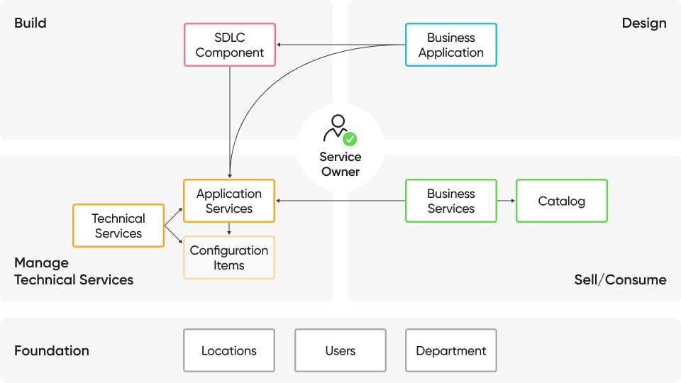
Data flow

Slide 11
Roles:
Educational organizations are the backbone of individual and societal progress. They primarily impart knowledge and develop crucial skills, equipping individuals with the academic foundations and practical abilities needed to navigate the world. Beyond academics, they foster holistic growth, nurturing intellectual curiosity, emotional intelligence, and social awareness. These institutions also play a vital role in transmitting culture and values from one generation to the next, ensuring the continuity of societal norms, traditions, and shared heritage. Simultaneously, they act as engines of social mobility and integration, providing opportunities for individuals from diverse backgrounds to improve their standing and promoting cohesion within communities. Crucially, educational organizations are significant drivers of economic development. By producing a skilled and knowledgeable workforce, they contribute directly to innovation, productivity, and national prosperity. They are essential for both personal enrichment and the collective advancement of society.

Slide 12
Advantages of educational organizations using ServiceNow
Improved Student Experience: Self-service portals, personalized support, faster issue resolution.
Boosted Staff Efficiency: Automates administrative tasks (HR, facilities, IT), centralizes communication.
Modernized IT Operations: Efficient ITSM, accurate asset management, proactive issue resolution.
Enhanced Collaboration: Breaks down silos, creates seamless workflows across departments.
Stronger Security & Compliance: Robust data protection, effective risk management.
Scalability & Flexibility: Customizable platform, adaptable to evolving institutional needs.

Slide 13
Disadvantages of educational organizations using ServiceNow
High Costs
Expensive subscription fees.
High implementation and setup costs.
Ongoing maintenance and support expenses.
Need for dedicated, specialized staff.
Complexity & Learning Curve
Overwhelming number of features.
Steep learning curve for users and administrators.
Can be difficult to navigate initially.
Time and resource-intensive to tailor.
Risk of over-customization leading to technical debt.
Can create overly complex workflows if not managed well.
Resistance to change from staff.
Complex data migration from old systems.
Requires strong governance to avoid chaos.
Lack of internal expertise can hinder success.
Heavy reliance on ServiceNow ecosystem can make switching difficult.

Slide 14
𝐂𝐨𝐧𝐜𝐥𝐮𝐬𝐢𝐨𝐧:
In conclusion, for educational organizations navigating the complexities of modern administration and striving to deliver exceptional learning experiences, ServiceNow provides a comprehensive, scalable, and adaptable platform. Its implementation marks a significant step towards digital transformation, fostering greater agility, efficiency, and a truly student-centric approach, ultimately contributing to the continued success and competitiveness of the institution in an evolving educational landscape.

Slide 15
𝐅𝐮𝐭𝐮𝐫𝐞 𝐬𝐜𝐨𝐩𝐞 𝐨𝐧 𝐞𝐝𝐮𝐜𝐚𝐭𝐢𝐨𝐧𝐚𝐥 𝐨𝐫𝐠𝐚𝐧𝐢𝐳𝐚𝐭𝐢𝐨𝐧
Enhanced Student Experience: Personalized student portals and self-service options. Streamlined admissions, enrolment, and support services. Proactive student support through AI and analytics.
Optimized Administrative & Campus Operations: Centralized platform for IT, HR, facilities, and asset management. Automated administrative workflows for efficiency.Efficient resource allocation and management. Improved inter-departmental communication and collaboration. * Data-driven decision-making for strategic planning.
Empowered Faculty & Staff: Simplified administrative tasks for faculty. Unified and efficient HR processes. * Faster and more effective IT support.
Advanced IT Management & Security: Modernized and scalable IT infrastructure. Proactive cybersecurity and data privacy.Integration with IoT devices for campus management. AI-powered IT operations for predictive insights.
Future Trends & Scope: Deeper integration of AI and Machine Learning for intelligent automation and virtual agents. Low-code/no-code development for rapid application creation. Unified AI ecosystem across all services. Support for ESG reporting and sustainability initiatives. Connecting campus operations with external stakeholders (alumni, donors).

Slide 16
Thank you

